Slide 1

Chapter 3 S3 +4
How to use HTML
to structure a web page

Slide 2
Objectives
How to code the head section
How to code text elements
How to structure to content of a page
How to code links, lists, and images
A structured web page.

Slide 3
How to code the head section

Slide 4
The Title element and Link to a favion
1. Title element
The head section of every page should include a unique title element that describes the content of the page. This title is used by search engines for search engine optimization, and it appears in the results of a search to help the user decide whether they want to go to that page.
2. Link to a favicon
A browser that shows the title and favicon
Notes:
- Nên có một slide chứa 01 trang Web và phân tích các thành phần trước khi đi vào chi tiết

Slide 5
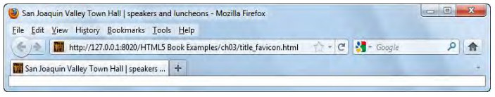

The Title element and Link to a favicon (Cont.)
A head section that specifies a title and links to a favicon
Notes:
Mô tả nội dung chi tiết từng chuyên đề

Slide 6
SEO guidelines for the title tag
Always code a title tag in the head section
The title should accurately describe the page’s content, and it should include the one or two keywords that you want the page ranked for
The title should be interesting enough to entice the reader to click on it when it’s shown in the search results for a search engine
The title should be unique for each page in your web site
Limit the length of your titles to around 65 character because most search engine don’t display more than that in their results.
Notes:
Cần trình bày cái này đơn giản hơn, ít chữ hơn

Slide 7
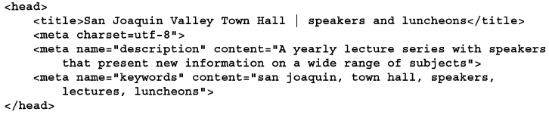
Include Metadata
The meta data element provides information about the HTML document that’s called metadata.
A head section that include metadata

Slide 8
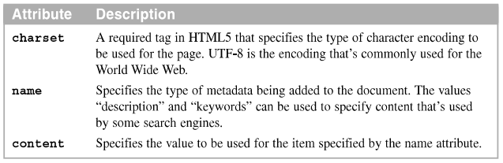
Include Metadata
- Three attributes of the <meta> tag.

Slide 9
How to code text elements

Slide 10
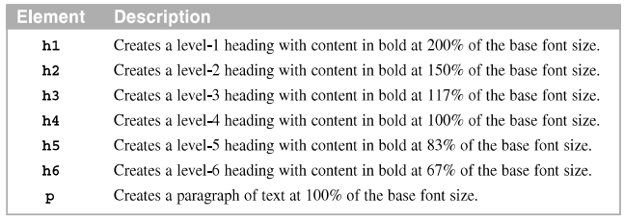
Headings and paragraphs
- Common block elements for headings and paragraphs

Slide 11
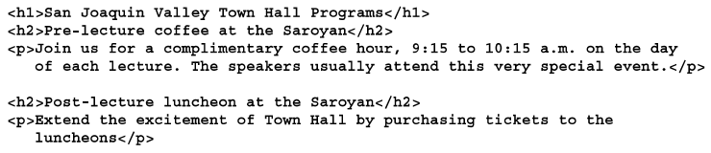
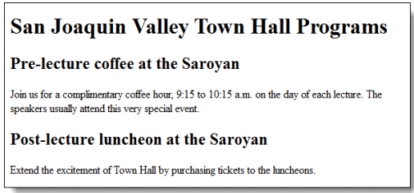
Headings and paragraphs
HTML that uses the block elements
The block elements in a web browser

Slide 12
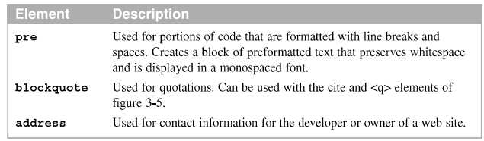
Special blocks of text
Block elements for special types of text

Slide 13
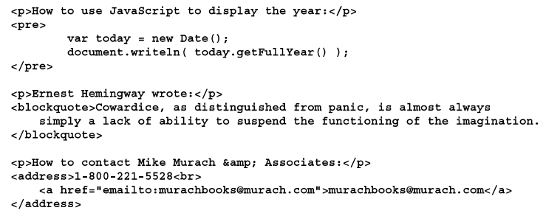
Special blocks of text
HTML that uses the block elements

Slide 14
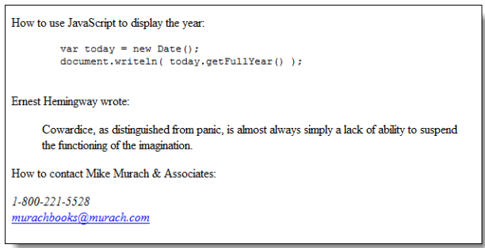
Special blocks of text
- The block elements in a web browser

Slide 15
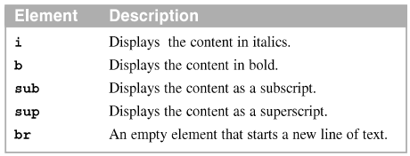
Inline elements for formatting and identifying text
An inline element is coded within a block and doesn’t begin on a new line.
Inline elements for formatting text

Slide 16
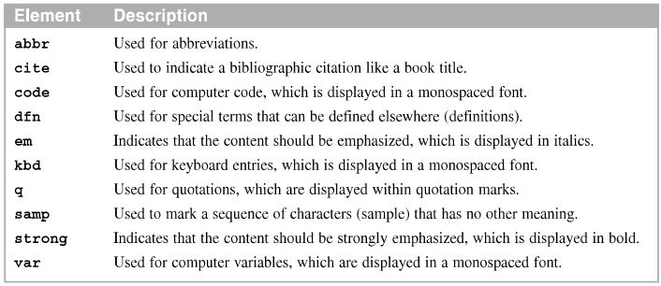
Inline elements for formatting and identifying text (cont.)
Inline elements for identifying content

Slide 17
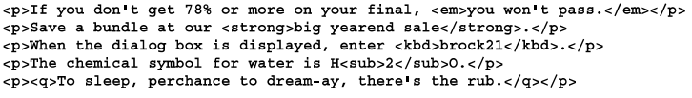
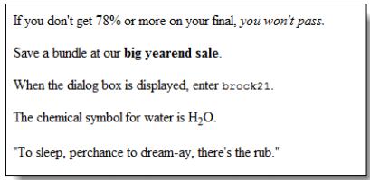
Inline elements for formatting and identifying text (cont.)
HTML that uses some of the inline elements
- The inline elements in a web browser

Slide 18
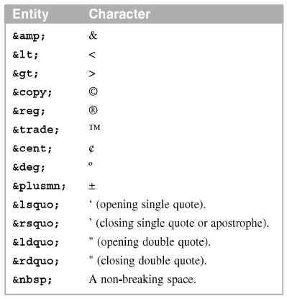
Character entities
Character entities can be used to display special character is an HTML document
Common HTML character entities

Slide 19
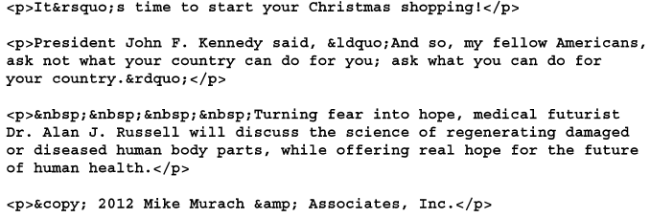
Example of character entites

Slide 20
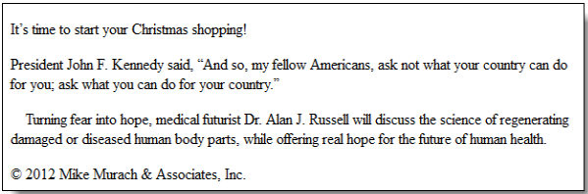
The character entities in a web browser

Slide 21
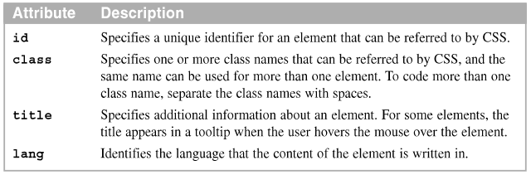
The core attributes
Core HTML attributes

Slide 22
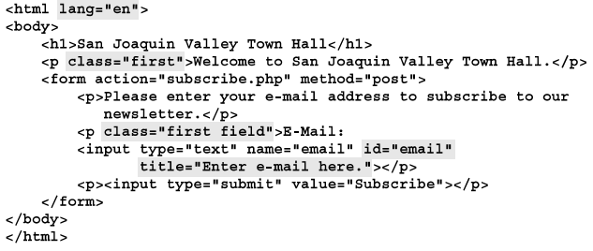
HTML that uses these attributes

Slide 23
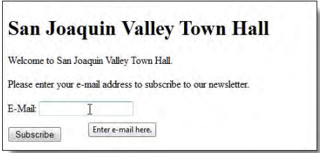
Result on browser

Slide 24
How to structure the content of a page

Slide 25


Div and span elements
A block element for structure a web page
An inline element for formatting text

Slide 26
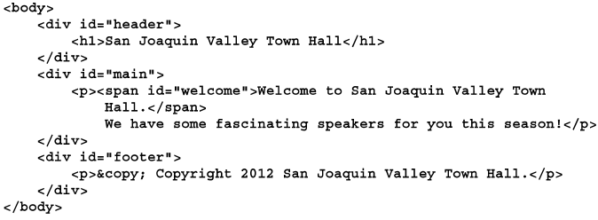
Div and span elements sample
A page that’s structured with div and span elements

Slide 27
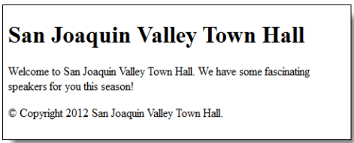
Result on browser
The page displayed in a web browser

Slide 28
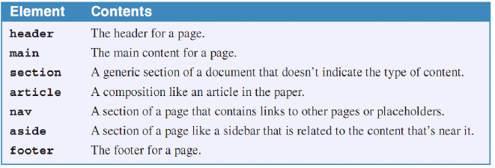
Structure a page with the HTML5 semantic elements
HTML5 provide new semantic elements that you should use to structure contents of web page.
Using these elements can be referred to as HTML5 semantic.
The primary HTML5 semantic elements

Slide 29
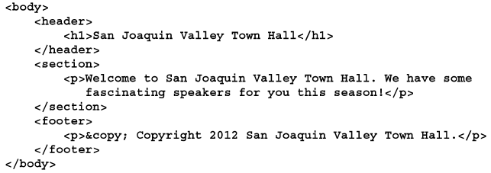
Sample
- A page that’s structure with header, section and footer

Slide 30
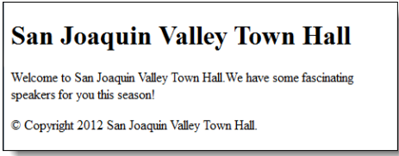
Result on browser
The page displayed in a web browser
Use the HTML5 semantic elements to indicate the structure of your pages

Slide 31
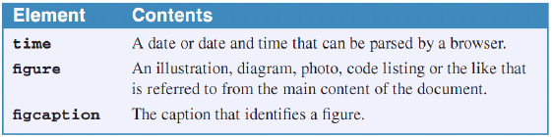
Some of the other HTML5 semantic elements
Although there are other HTML5 semantic elements, these are the most useful ones that are currently supported by modern browser.
Other HTML5 semantic elements

Slide 32
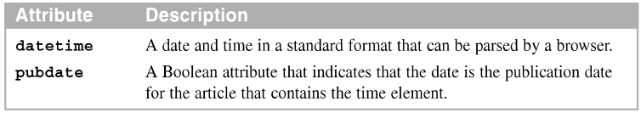
Some of the other HTML5 semantic elements (cont.)
The attributes of the time element
A time element

Slide 33
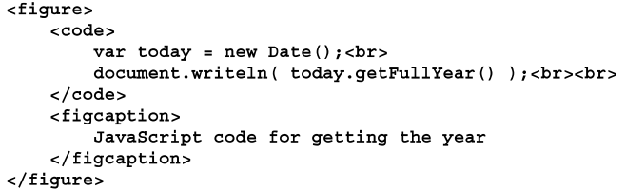
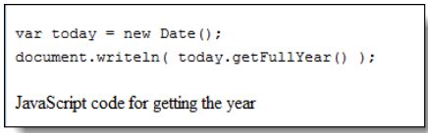
Some of the other HTML5 semantic elements (cont.)
The figure and figcaption elements
The code displayed in a browser

Slide 34
How to code links, list and images
Notes:
Session: Ghi số thứ tự session trong môn học
Session Name: ghi tên của session sẽ dạy

Slide 35
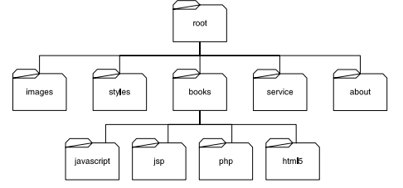
Absolute and relative URLs
Absolute URL, you code the complete URL including the domain name for the site. Absolute URLs let you display pages at other websites.
Relative URL, you base it on the current folder, which is the folder that contains the current page.

Slide 36
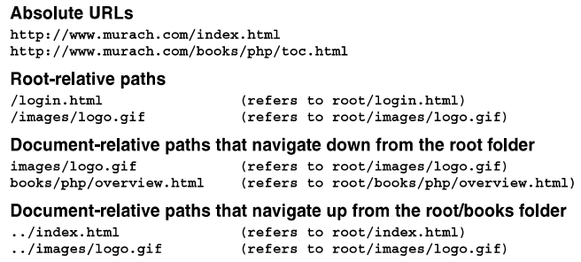
Absolute and relative URLs - Example

Slide 37

Links
The <a> element is an inline element that creates a link that load another web page. The href attribute of this element identifies the page to be loaded.
Basic attribute of the <a> element

Slide 38
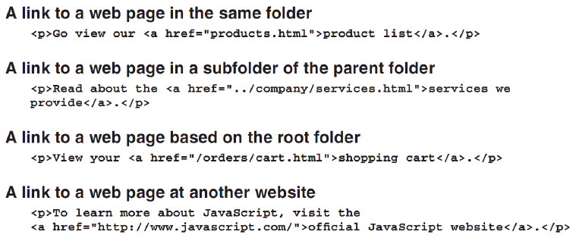
Example

Slide 39
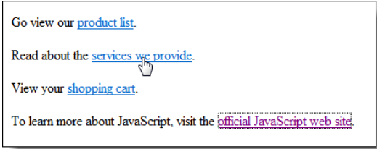
Result
- The link in a web browser

Slide 40
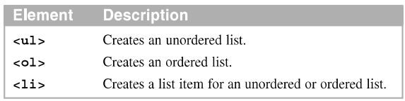
Lists
The two basic type of lists are unordered lists and ordered list.
By default, an unordered list is displayed as a bulleted list and an ordered list is displayed as a numbered list.
Elements that create ordered and unordered lists
Notes:
Nên trình bày hình ảnh cho sinh động

Slide 41
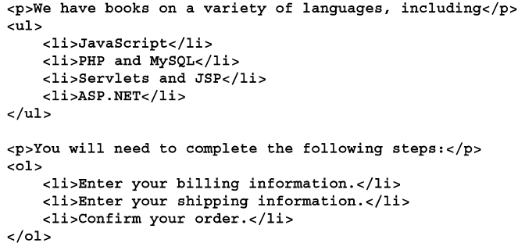
Lists - Example
- HTML that creates two lists

Slide 42
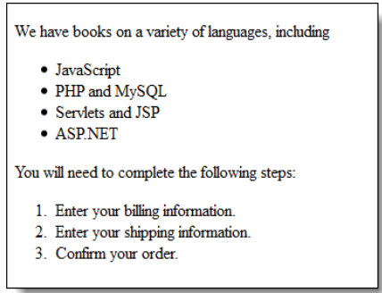
Lists – Example (cont.)
- The lists in a web browser

Slide 43
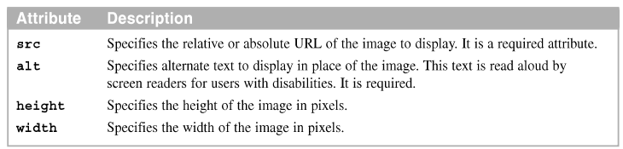
Include images
The img element is an inline element that is used to display an image that’s identified by the src attribute
Attributes of the <img> element
An img element

Slide 44
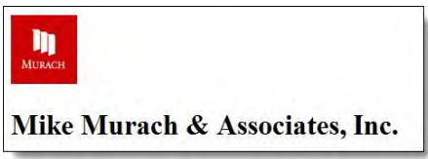
Include images (cont.)
The image in a web browser
The image formats that are supported by most browsers
JPEG, GIF, PNG
Accessibility guidelines
For images with useful content, always code an alt attribute that describes the image
For image that are used for decoration, code the alt attribute with no value(“”)

Slide 45
A structure web page
Notes:
Session: Ghi số thứ tự session trong môn học

Slide 46
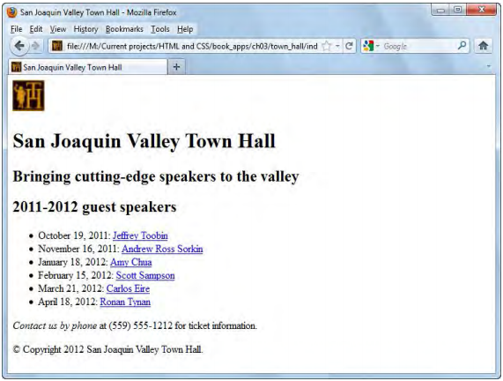
The page layout
- A web page that uses some of the HTML presented in this chapter

Slide 47
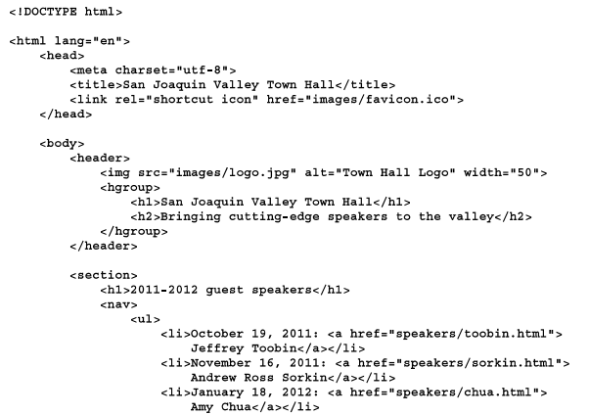
The HTML file

Slide 48
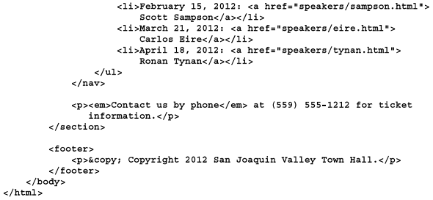
The HTML file (cont.)

Slide 49
Summary
Head section of an HTML document
Metadata elements in the head section provide metadata that is related to the page.
Block element and Inline elements
Character entities
Core attribute that common used for HTML
HTML5 semantic elements
Absolute and Relative URL
Links and List elements
Img element to display image file in HTML

